Slide 1
Pico Engine JavaScript Module
Presented By Adam Burdett.
Notes:
Hi, My name is Adam Burdett and Im presenting my research into Pico Engine javascript modules.

Slide 2

Pico Engine
Notes:
The Pico Engine is an emerging IoT platform that evaluates KRL rules against events associated with Pico device shadows.

Slide 3
KRL Example
rule hello_world {
select when echo hello
send_directive("say", {"something": "Hello World"})
}
Notes:
This is the Hello world KRL rule. This rule selects on a echo hello event and sends a directive called say with an object containing the string hello world.

Slide 4
JavaScript Modules
rule hello_world {
select when echo hello
send_directive("say", {"something": random:word()})
}
Notes:
The Pico Engine provides a standard library in the form of KRL modules. For example we have just changed the hell world rule to return a directive with a random word instead of a hello world string. This is done by calling an engine module called random with a function called word. But what if you have an amazing idea for a killer app which requires a module the engine doesn't provide?
For example what if your killer app needs cowsay,

Slide 5
JavaScript Modules
rule hello_world {
select when echo hello
send_directive("say", {"something": cowsay:say("Pico")})
}
Notes:
You would like a module called cowsay with a function called say. This function would take a string and return…

Slide 6
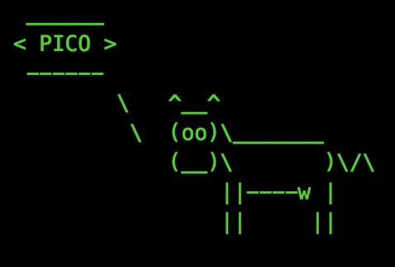
JavaScript Modules
rule hello_world {
select when echo hello
send_directive("say", {"something": cowsay:say("Pico")})
}
Notes:
The Cowsay of that string. My research was done by investigating the engines potential to provide users the ability to create custom javaScript Modules.
It was believed the Pico engine had the potential to extend KRL with custom JavaScript modules, but was never developed until now. This research developed user-defined JavaScript modules for the Pico engine and proposed and tested a single Pico to a single resource model.

Slide 7
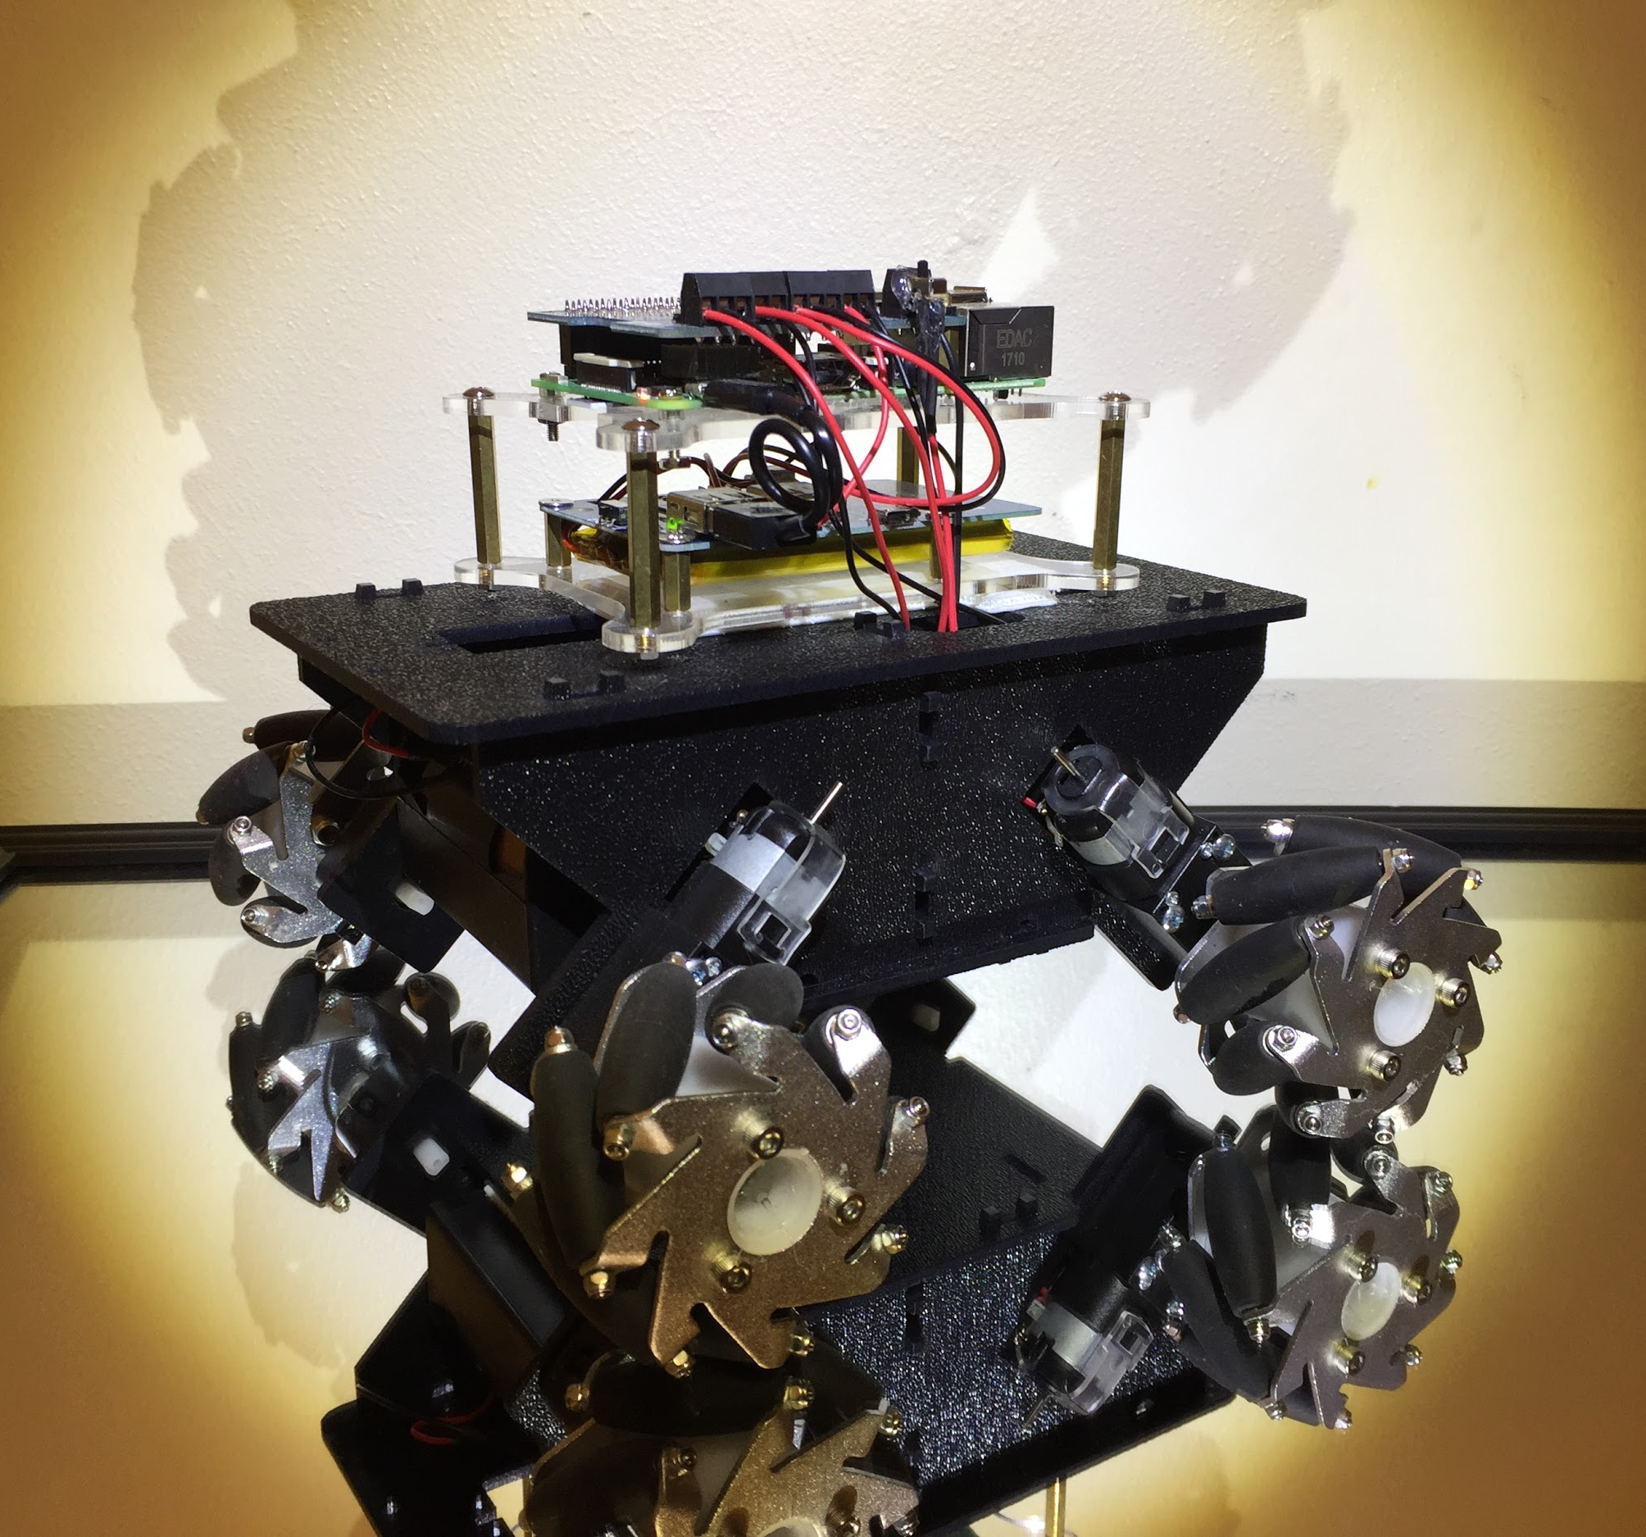
Pico Rover
Notes:
To drive this research I proposed developing a pico rover. The idea is to extend KRL language to natively manage hardware on the raspberry pi. I am going to cover the main hardware of the pico rover.

Slide 8
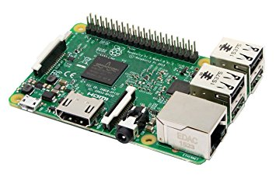
Raspberry Pi
Notes:
The pico rover is controlled by a raspberry pi, which is a small computer that runs linux. This is ideal because the pico engine is built on top of node.js, which the raspberry pi supports.

Slide 9
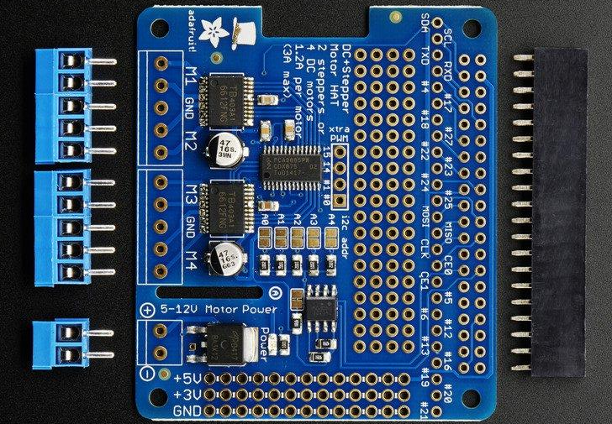
Motor Controller
Notes:
This is an adafruit motor controller. I specifically picked this controller because I was able to find a node.js library that supports it. I will explain later in the slides why that was important.

Slide 10
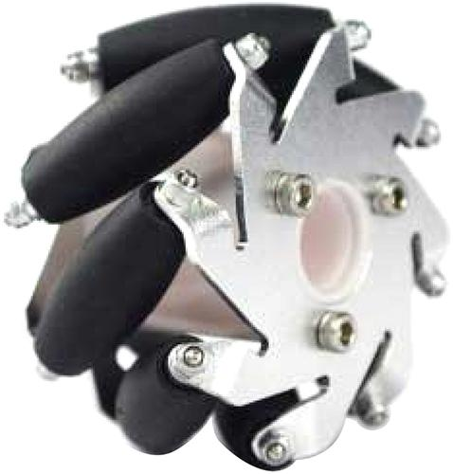
Mecanum Wheels
Notes:
Go Big or Go Home! Right? This is a mecanum wheel. It has a free floating roller that sits on a 45 degree angle, which allows the pico rover to move in any direction.
I chose this so it would help strain test my model.

Slide 11
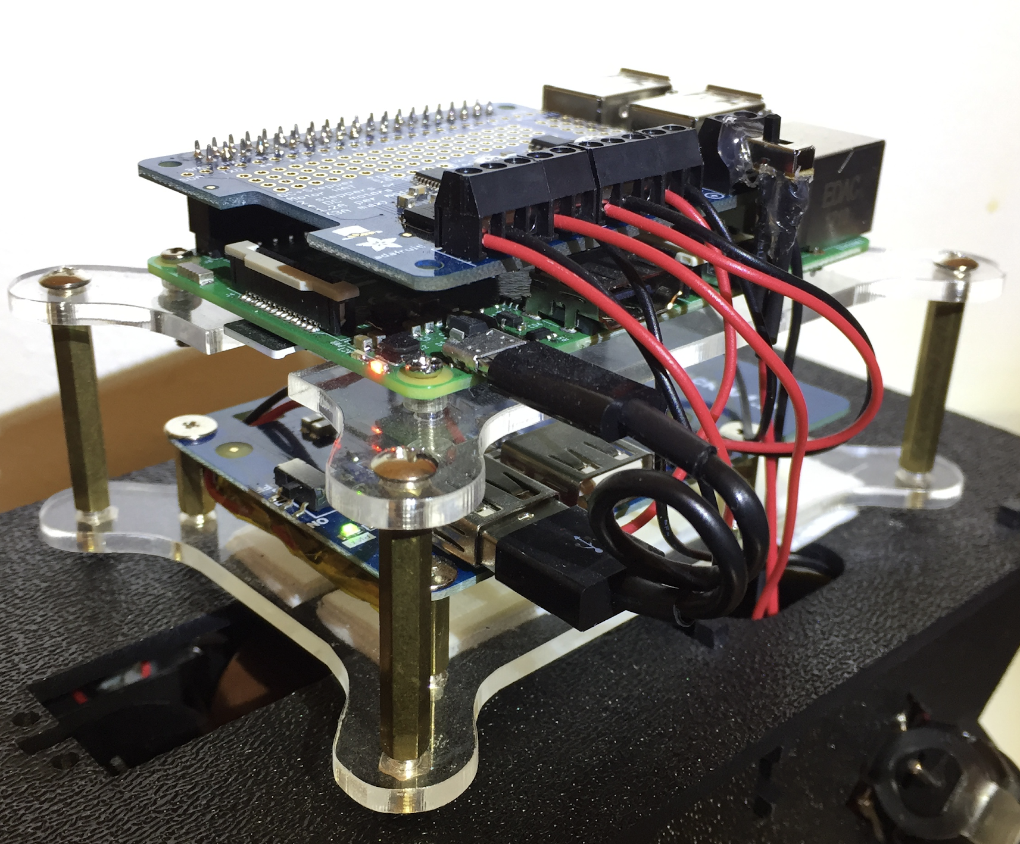
Pico Rover
Notes:
I will now go into details about the software.

Slide 12
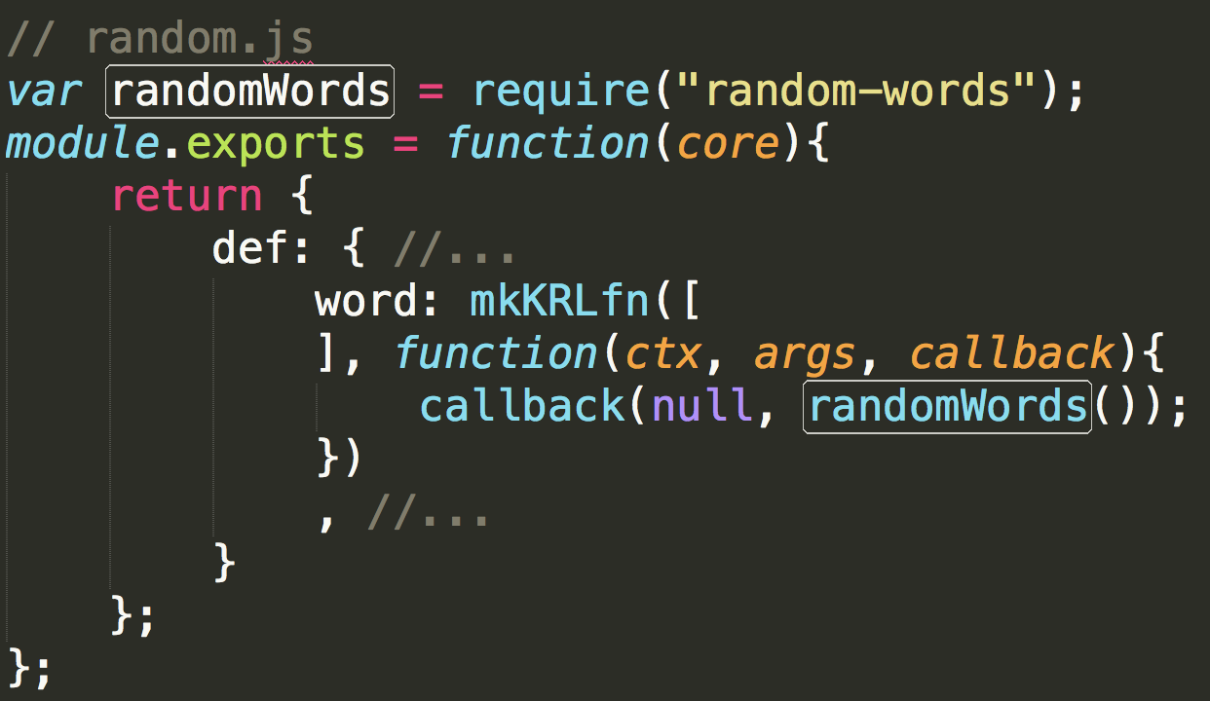
Extending KRL
Notes:
Remember back to the random word example. I was able to find in the engine where that module is declared.
Random module lives in random.js. In there I found require “random words” being called. This is important because that is a node js library.

Slide 13

Extending KRL
Notes:
I also recognize module.exports. This is how node.js exports module objects.

Slide 14

Extending KRL
Notes:
If you look at where random words library is being called, you will realize that it is simply being wrapped inside the exported object. This is when I realized all that needs to be done is adding a configuration for a developer to add a js file and describe exactly what the engine is expecting to see in that exported object.
I made these feature suggestions to the main engine developer and a new module pattern was developed.

Slide 15
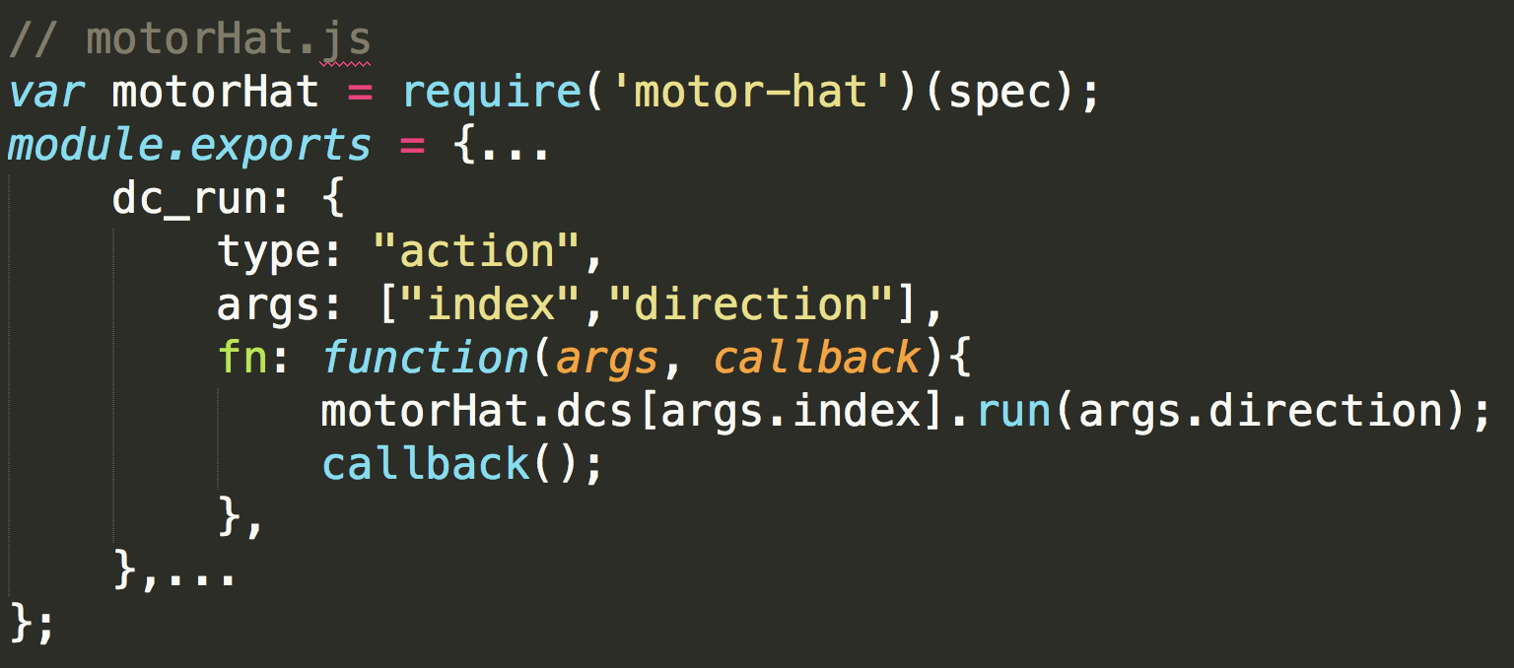
Extending KRL
Notes:
This is code taken from the motorHat.js library this research produced. Remember I picked a motor driver I found a node.js module for.

Slide 16
Extending KRL
Notes:
This is where I called it. Being able to use that library prevented me from rewriting all the low level code.
NPM is a package manager used for node.js. The pico engine is build on node js, which makes all the libraries of npm easily added as modules in the engine.

Slide 17
Extending KRL
Notes:
Notice motorHat.js exports a node module object just as before. But this object is declared a little differently. I declare the name of the modules function, dc_run and provide configuration that the engine is expecting. The important part is to note that we call the motor-hat library and wrap it in the object that's exported.

Slide 18
MotorHat Modules
rule hello_world {
select when echo hello
motorHat:dc_run(1,"fwd")
}
Notes:
This is the same helo world rule from earlier. but the directive has been replaced with my new dc_run function provided by the motorHat module. This would start moving the second wheel forward when a echo hello event is raised.

Slide 19
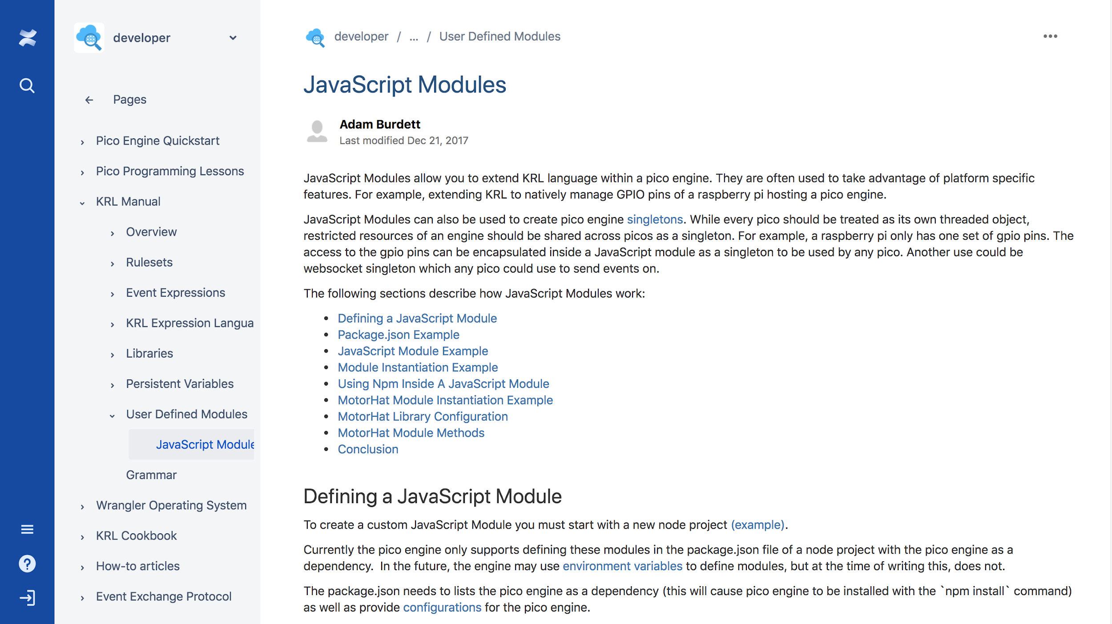
Documentation
https://picolabs.atlassian.net/wiki/spaces/docs/pages/96370693/JavaScript+Modules
Notes:
For greater detail you can go to my documentation on the picolabs website.

Slide 20
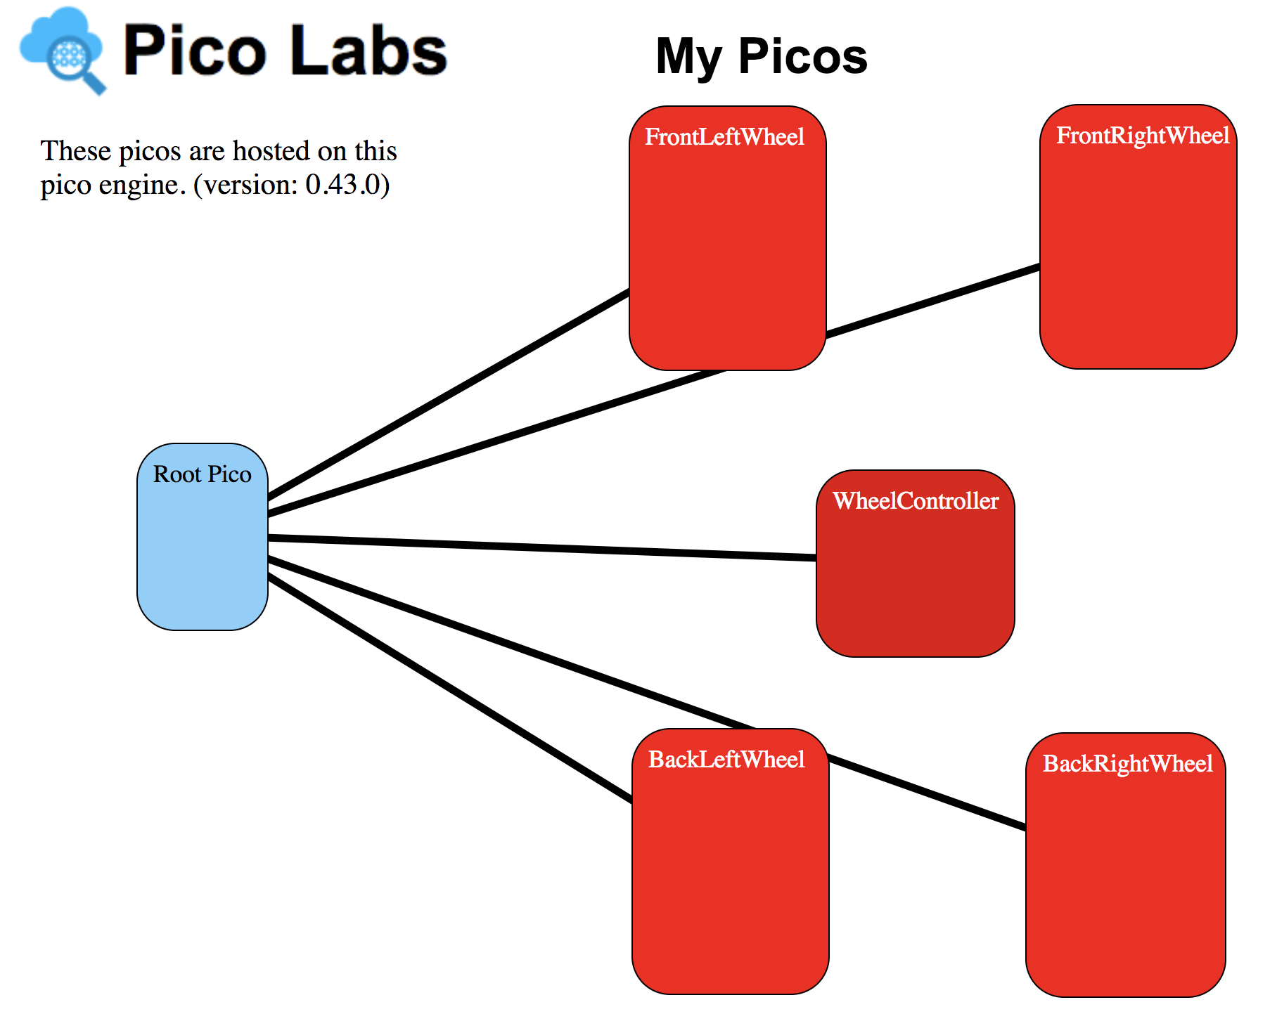
Pico Rovers System
Notes:
The single Pico to single resource model was implemented where each wheel motor connected to the motorHat is accessed by a single Pico which controls its direction and speed.

Slide 21
Pico Rovers System
Notes:
The single Pico to single resource model was implemented where each wheel motor connected to the motorHat is accessed by a single Pico which controls its direction and speed.

Slide 22
Pico Rovers System
Notes:
The single Pico to single resource model was implemented where each wheel motor connected to the motorHat is accessed by a single Pico which controls its direction and speed.

Slide 23
Pico Rovers System
Notes:
The single Pico to single resource model was implemented where each wheel motor connected to the motorHat is accessed by a single Pico which controls its direction and speed.

Slide 24
Pico Rovers System
Notes:
The single Pico to single resource model was implemented where each wheel motor connected to the motorHat is accessed by a single Pico which controls its direction and speed.

Slide 25
Pico Rover Demonstration

Slide 26
Questions

Slide 27
References
https://www.xtendiot.com/wp-content/uploads/2017/08/iot-platform.jpg
https://images-na.ssl-images-amazon.com/images/I/91zSu44%2B34L._SX355_.jpg
https://cdn-shop.adafruit.com/970x728/2348-05.jpg
https://www.robotshop.com/media/files/images2/60mm-mecanum-wheel-set-2x-left-2x-right-2.jpg
https://github.com/Picolab/pico-rover/blob/master/motor-hat.js
https://eg2.gallerycdn.vsassets.io/extensions/eg2/vscode-npm-script/0.3.3/1509888056659/Microsoft.VisualStudio.Services.Icons.Default

Slide 28
References
https://i2.wp.com/garywoodfine.com/wp-content/uploads/2016/02/nodejs.png?fit=1200%2C335&ssl=1&resize=350%2C200

